Slide 1
Computer Networks

Slide 2
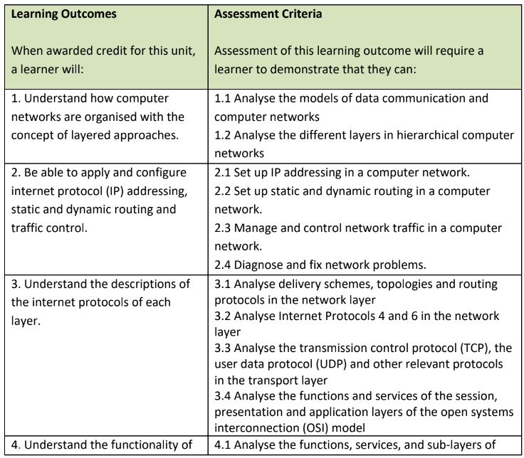
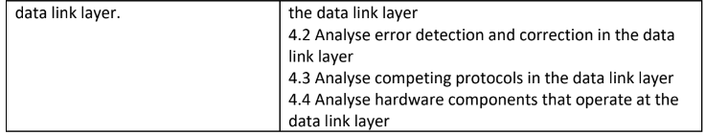
Learning Outcomes

Slide 3
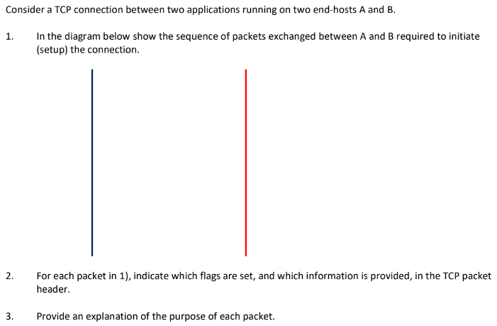
Part 1:

Slide 4
Question 1:
TCP first establish a reliable connection using a 3-way handshake.
When host A wants to communicate with Host B
It sends a SYN packet → “I want to start a connection”
Host B replies with SYN + ACK → “Okay, I accept + here is my sequence number”
Host A sends ACK → “Confirmed”
Then the connection is established.

Slide 5
Question 2:
Each TCP packet has flags and header fields.
SYN (Synchronize) → Used to start a connection
ACK (Acknowledgment) → Confirms received data
Sequence Number → Tracks data order
Acknowledgment Number → Confirms received bytes

Slide 6
Question 3:
SYN - Start communication
SYN-ACK - Accept + respond
ACK - Final confirmation
These 3 steps need because:
Both sides must:
Agree on communication
Synchronize sequence numbers
Ensure reliability from the start

Slide 7
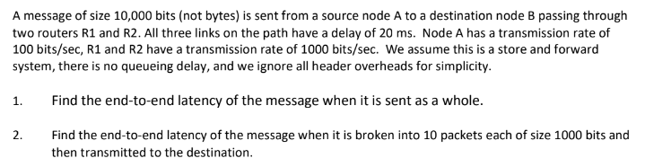
Part 2:

Slide 8
Question 1:
There are two main delays:
Transmission Delay → Time to put bits onto the link
Propagation Delay → Time for signal to travel
In a store-and-forward network, each router must:
Receive the entire message
Then forward it
As given in the question node A is slow (100 bps) → main bottleneck.
Routers are faster (1000 bps). Most delay comes from the first link. This is why total delay becomes very high

Slide 9
Question 2:
Now instead of sending 10,000 bits at once we send 10 packets of 1000 bits.
Routers don’t wait for the whole message. They forward packet-by-packet.
This creates pipelining.
First packet takes full path time. Remaining packets follow like a conveyor belt.
Total delay is reduced. Network becomes more efficient.

Slide 10
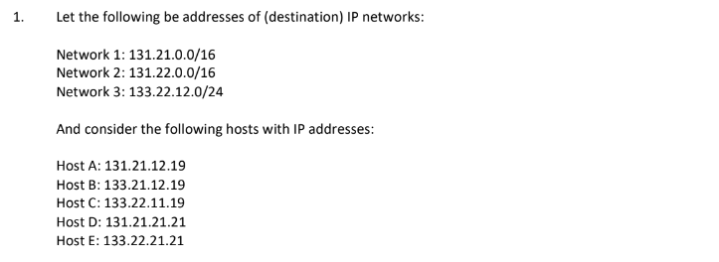
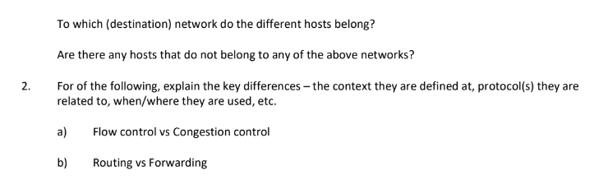
Part 3:

Slide 11
Question 1:
IP networks use prefix notation (CIDR).
/16 → first 16 bits = network
/24 → first 24 bits = network
To check we compare the network portion of IP address.
131.21.x.x → belongs to Network 1
131.22.x.x → belongs to Network 2
133.22.12.x → belongs to Network 3
If it doesn’t match → not in any network

Slide 12
Question 2 (a):
Flow Control prevents receiver from being overwhelmed.
Managed by Transmission Control Protocol. (Receiver says: “Send slower, I can’t handle more”)
Congestion Control happens in the network.
Prevents too much traffic overall

Slide 13
Question 2 (b):
Routing decides best path.
Happens using protocols like Open Shortest Path First.
Forwarding moves packets.
Uses routing table.
Routing - Decision making | Control plane
Forwarding – Action | Data plane

Slide 14
Referencing Requirements (Harvard Format)
• All assignments must follow Harvard Referencing Style.
• A minimum of 20 academic references is required.
• Every in-text citation must match the reference list.
Example
Relational database normalization significantly enhances data integrity by eliminating redundancies (Codd, 1970). According to Connolly and Begg (2015), the normalization process through successive normal forms prevents update anomalies that could compromise transactional consistency. Recent studies in gaming platforms specifically highlight how 3NF structures prevent data corruption in multi-player environments (Chen et al., 2020). However, some researchers argue that excessive normalization may impact query performance in high-volume systems (Silberschatz et al., 2019).
Reference List
Codd, E.F. (1970) 'A relational model of data for large shared data banks', Communications of the ACM, 13(6), pp. 377-387.
Connolly, T.M. and Begg,
C.E. (2015) Database systems: a practical approach to design, implementation, and management. 6th edn. Harlow: Pearson Education.

Slide 15
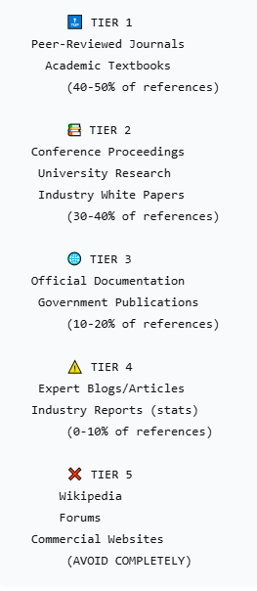
Academic Reference Priority Hierarchy

Slide 16
Formatting
• Font Style : Times New Roman / Calibri
• Font Size : 12 for content / 13 for heading
• Page numbers must be included

Slide 17
Mistakes to Avoid
• Submitting assignments with fewer than 20 references.
• Failing to match in-text citations with the reference list.
• Plagiarism – copying content without proper citation. This will result in disqualification.
• Writing descriptive content only, without critical analysis.
• Ignoring the application of theories to practical scenarios.

